Slide 1
Francisco Goya
(1746-1828)
History of Western Art
BFA-II (Visual Arts)
Course Incharge: Ms. Farah Khan
Institute of Design & Visual Arts (LCWU)

Slide 2
“I have had three masters; Nature, Velasquez and Rembrandt”
Francisco Goya
“The object of my work is to report the actuality of events”
Francisco Goya

Slide 3
Francisco Goya
Francisco Goya was a Spanish painter born in Aragon, located in north Spain.
He was a man having complex personality. He was a versatile artist, did paintings, etchings, aquatints, lithography and also worked for tapestry factory.
Goya occupies a unique position within the history of Western art, and is often cited as both an Old Master and the first truly modern artist.
Goya painted the Spanish royal family, including Charles IV of Spain and Ferdinand VII.
His thematic range extended from merry festivals for tapestry, draft cartoons, to scenes of war and human debasement. This evolution reflects the darkening of his temper.
Near the end of his life, he became reclusive and produced frightening and obscure paintings of insanity, madness, and fantasy, while the style of the Black Paintings prefigures the expressionist movement.
He once said: “The whole world is a farce: its faces, its appearance, its voices—all are a nightmare. Every one wants to seem what they are not, all deceive each other and no one knows himself”.
He was inspired by Velazquez and Rembrandt’s use of chiaroscuro, and used the desired light and atmosphere in rendering the mass of a figure in his work.

Slide 4
Francisco Goya
At the age of 18 he joined the studio of Bayeu where he made cartoons for the royal tapestry factory. He replaced foreign subject matter with scenes from everyday contemporary Spanish life.
When he was 30, became the principle designer for tapestry factory, also did a series of cartoons for them.
In 1789 he was finally appointed Royal painter by the monarch Charles IV and he devoted himself for his portraits.
At the height of his career in 1792, a mysterious illness struck Goya which dramatically altered his life. The outcome was total deafness for the rest of his life.
In 1808, Peninsular war started that ended in 1814. Brought out the brutal killings and reaction of the war. The French occupied Spain and they put Napoleon’s brother on throne.
Goya’s work of that phase deeply narrate the full account of war’s horror, his reaction was more graphical than any other artist before.
He went out that night in the streets of Spain and witnessed the brutal bloodshed and injustice. He also painted the disasters of wars in his own individualistic style.
After 1814 he moved to a house of a deaf man where he painted the 14 black paintings.

Slide 5
Francisco Goya
More than anything else, Goya was a great individualist, the Romantic rebel who defied all canons of taste in subject matter and technique…..and often in his personal life.
A violent sense of reality expressed through the vivid colors and dynamic rhythms of his canvases, make Goya the arch-symbol of self-expression carried to its highest and most significant point.
Standing on the threshold of the modern world, he embraces in his art the Romantic, Realistic, Impressionist and even expressionist points of view.
Goya’s entire career was a protest against the conditions of his time. He was a social critic in his way of expressiveness.
According to him “Fantasy, abandoned by reason, produces impossible monsters; united with it, she is the mother of the arts and the origin of marvels”.
He also said that “The act of painting is about one heart telling another heart where he found salvation”.

Slide 6
Analysis
Goya painted the formal portraits of the Spanish Court skillfully, and highlighted the wealth and power of the royal household. On the other hand, these works have been seen to contain veiled, even sly, criticisms of the ineffectual rulers and their circle.
Goya was one of the greatest printmakers of all times, and was famous for his achievements in etching and aquatint. He created four major print portfolios during his career: the Caprichos, Proverbios, Tauromaquia, and The Disasters of War. Perhaps even more than his paintings, these works reflect the artist’s originality and his true opinions about the social and political events of his day. The subject matter of his etchings veers from dreamlike to grotesque, documentary to imaginary, and humorous to harshly satirical.
Women occupy a central place within Goya’s compositions, and his images of majas (the stylish and outlandish members of Spain’s lower classes in the 18th and 19th centuries), witches, and queens are some of his most daring and modern interpretations, depicting women in possession of their own powers, whether political or sexual. Many of these works have led to speculation about Goya’s private life, for example his supposed affair with the Duchess of Alba.

Slide 7
Analysis
Goya’s late paintings are among the darkest and most mysterious of his creations. His series of 14 paintings from his farmhouse on the outskirts of Madrid (the so-called “Black Paintings”) contain images of violence, despair, evil, and longing. They are the pessimistic expressions of an aging, deaf artist who was disillusioned with society and struggling with his own sanity.
His art embodies Romanticism’s emphasis on subjectivity, imagination, and emotion, characteristics reflected most notably in his prints and later private paintings. At the same time, Goya was an astute observer of the world around him, and his art responded directly to the tumultuous events of his day, from the liberations of the Enlightenment, to the suppressions of the Inquisition, to the horrors of war following the Napoleonic invasion.
Both for its inventiveness and its political engagement, Goya’s art had an enormous impact on later modern artists. His unflinching scenes from the Peninsular War presaged the works of Pablo Picasso in the 20th century, while his exploration of bizarre and dreamlike subjects in the Caprichos laid the foundation for Surrealists like Salvador Dali. Goya’s influence extends to the 21st century, as contemporary artists have also drawn inspiration from the artist’s grotesque imagery and searing social commentary.

Slide 8
“My work is very simple. My art reveals idealism and truth”
Francisco Goya

Slide 9
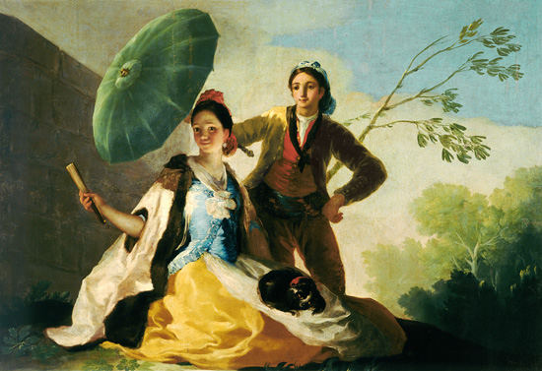
The Parasol

Slide 10
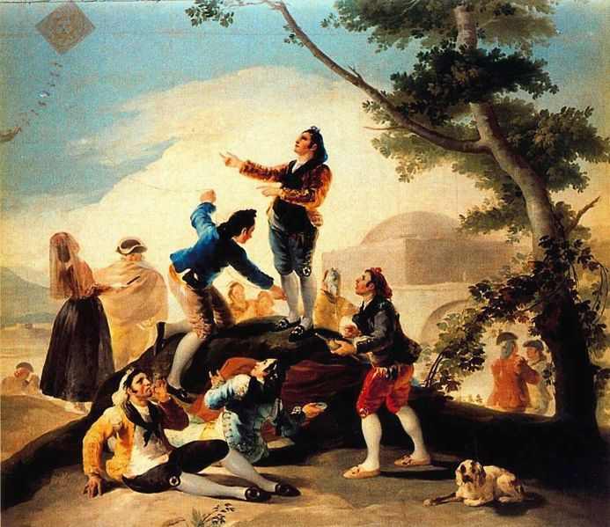
La Cometa

Slide 11
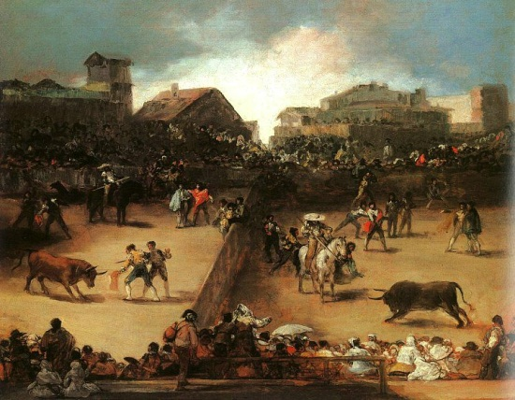
Bull Fight

Slide 12
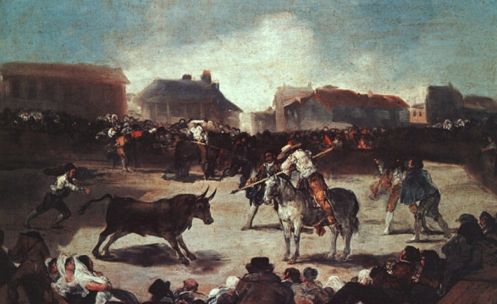
Bull Fight

Slide 13
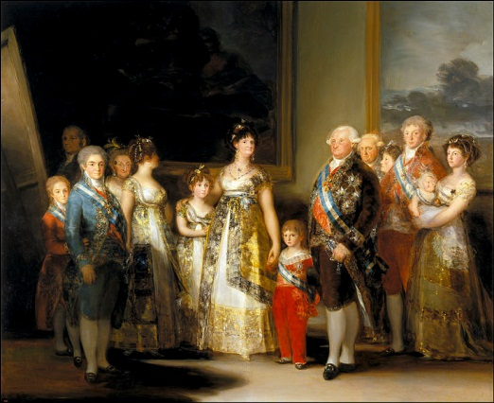
Family of Charles IV

Slide 14
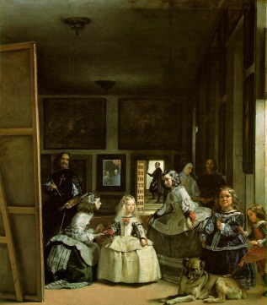
La Meninas by Velazquez

Slide 15
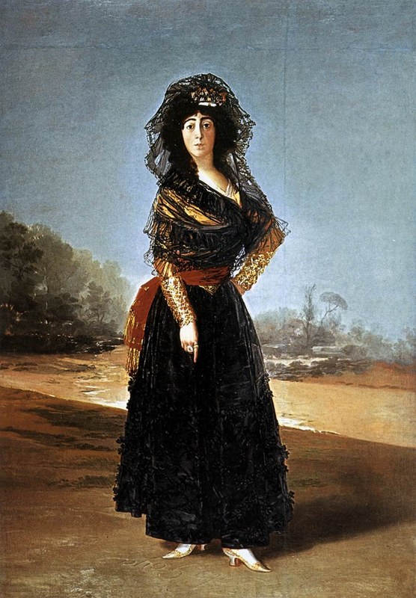
Duchess of Alba

Slide 16
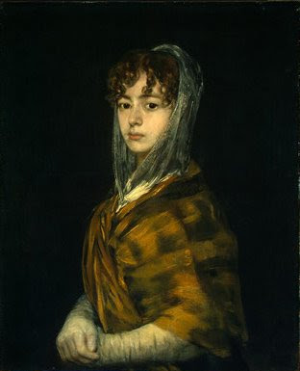
Portrait of a woman

Slide 17
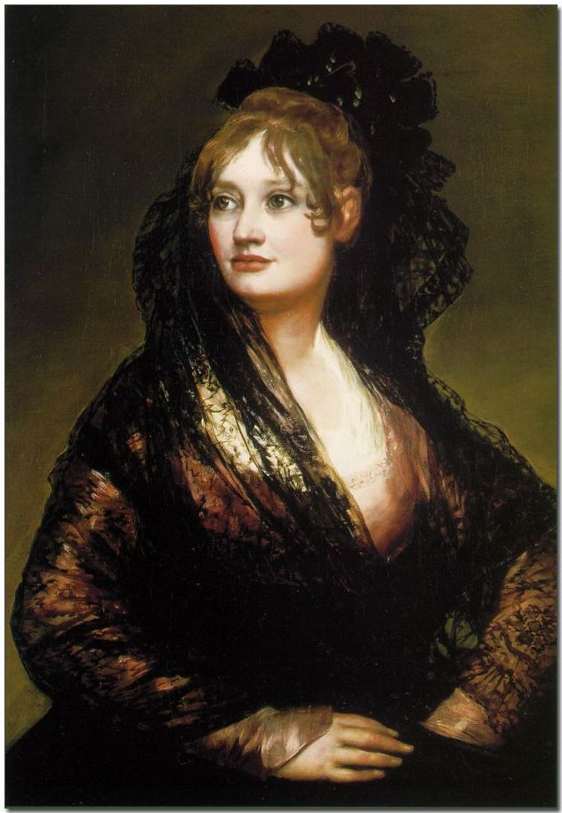
Portrait of a woman

Slide 18
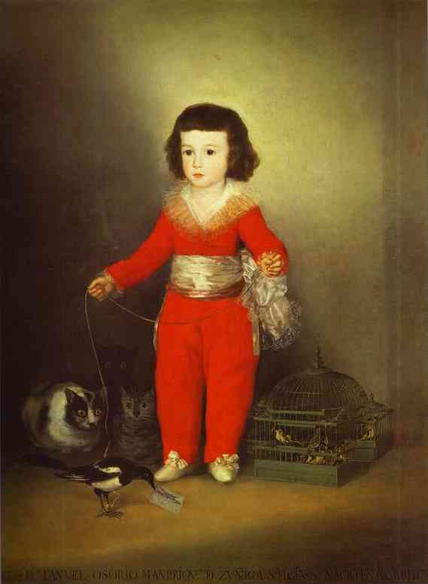
Manuel Osorio De Zuniga

Slide 19
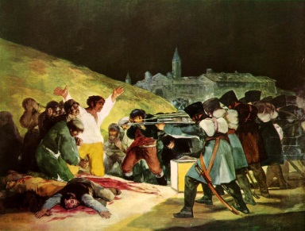
3rd May, 1808

Slide 20
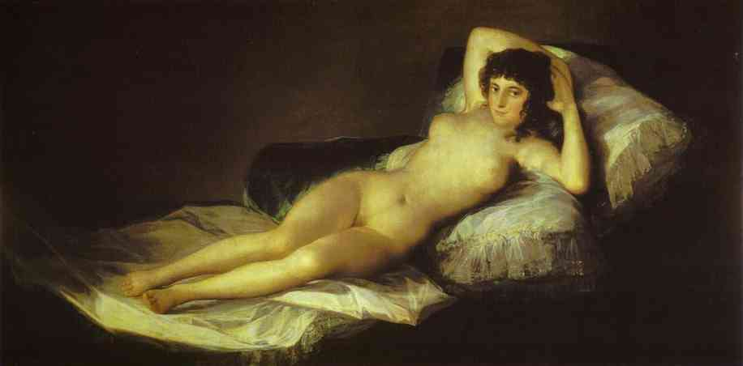
Nude Maja

Slide 21
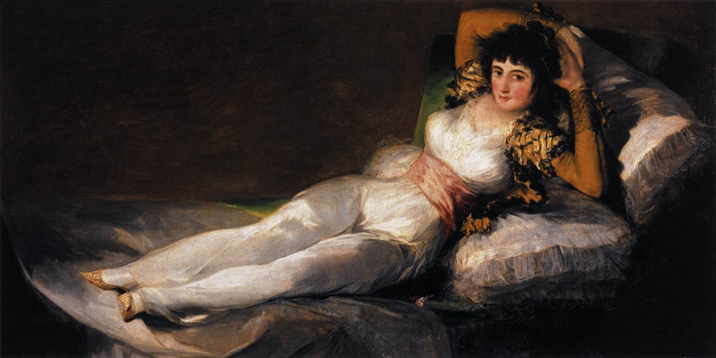
Clothed Maja

Slide 22
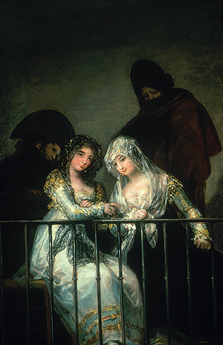
Majas on Balcony

Slide 23
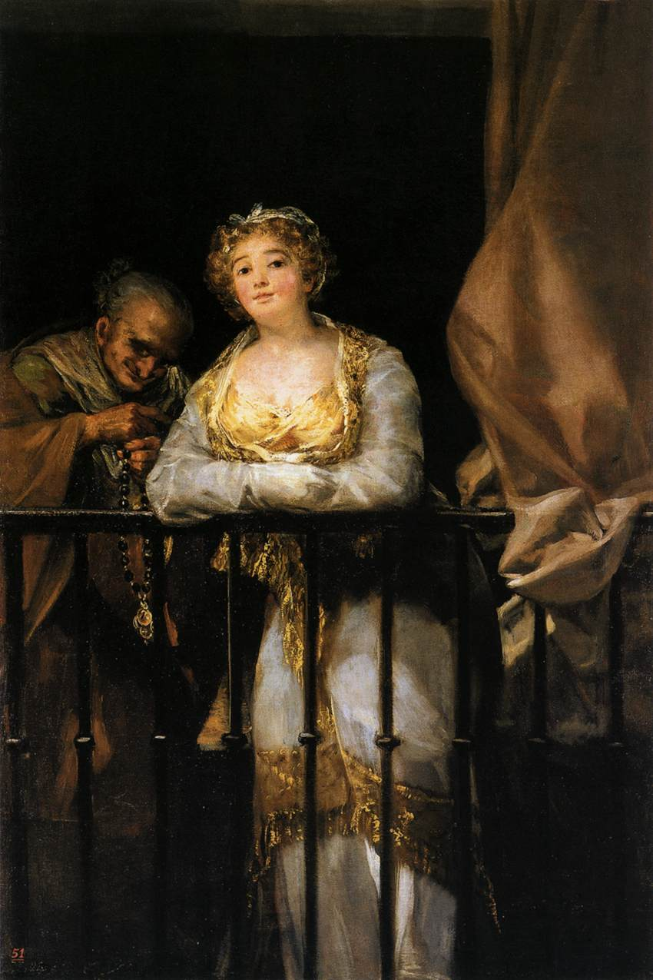
Maja and Celestina

Slide 24
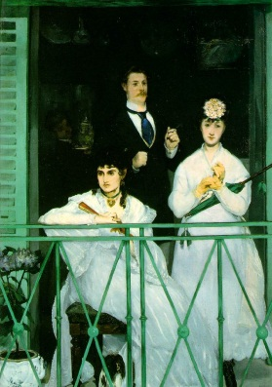
Balcony by Manet

Slide 25
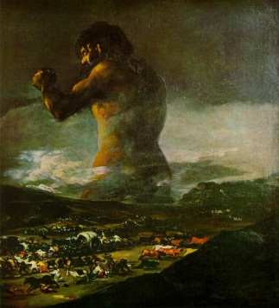
Colossus

Slide 26
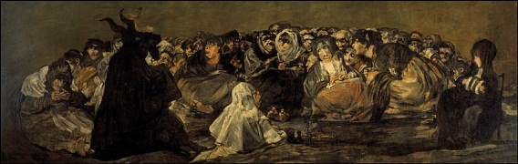
Witches Sabbath

Slide 27
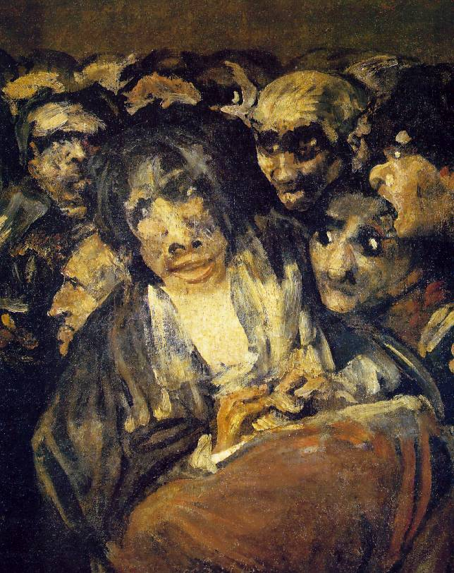
Close up study

Slide 28
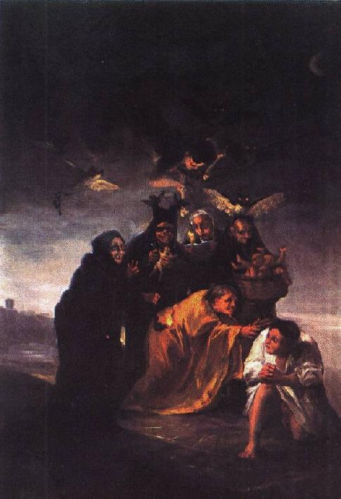

Slide 29
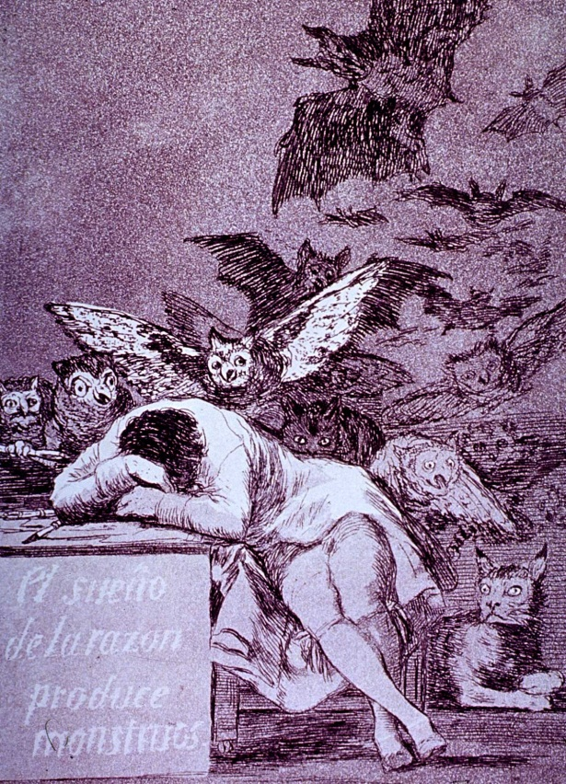
The Dream of Reason produces Monsters

Slide 30
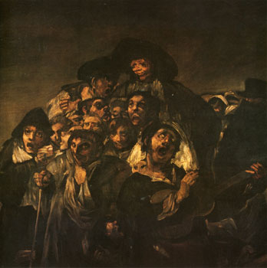
Close up study of a painting

Slide 31
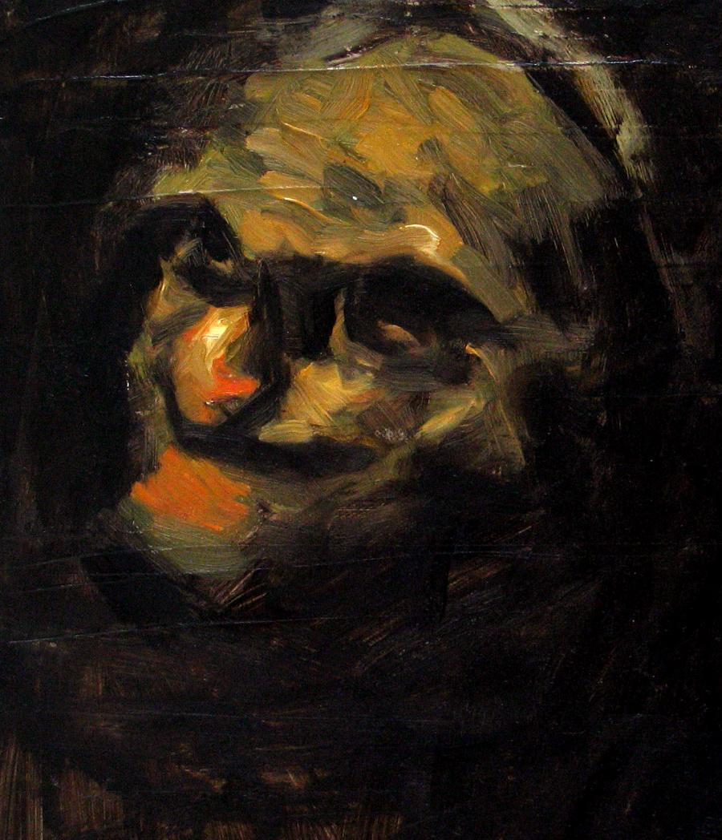
Close up study of an old woman

Slide 32
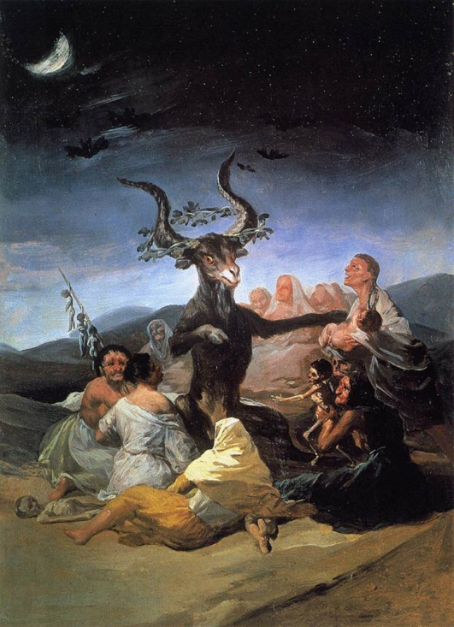
The Great Goat

Slide 33
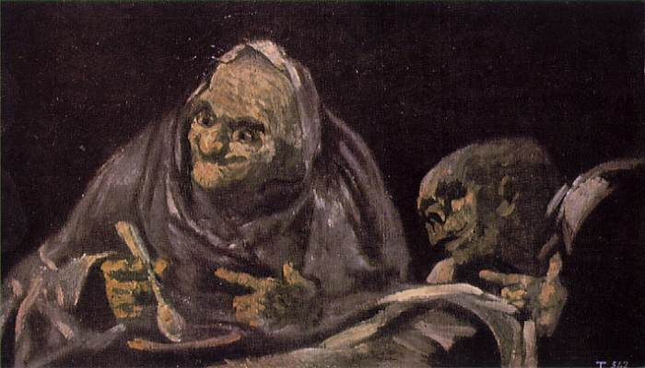
Two Old Women

Slide 34
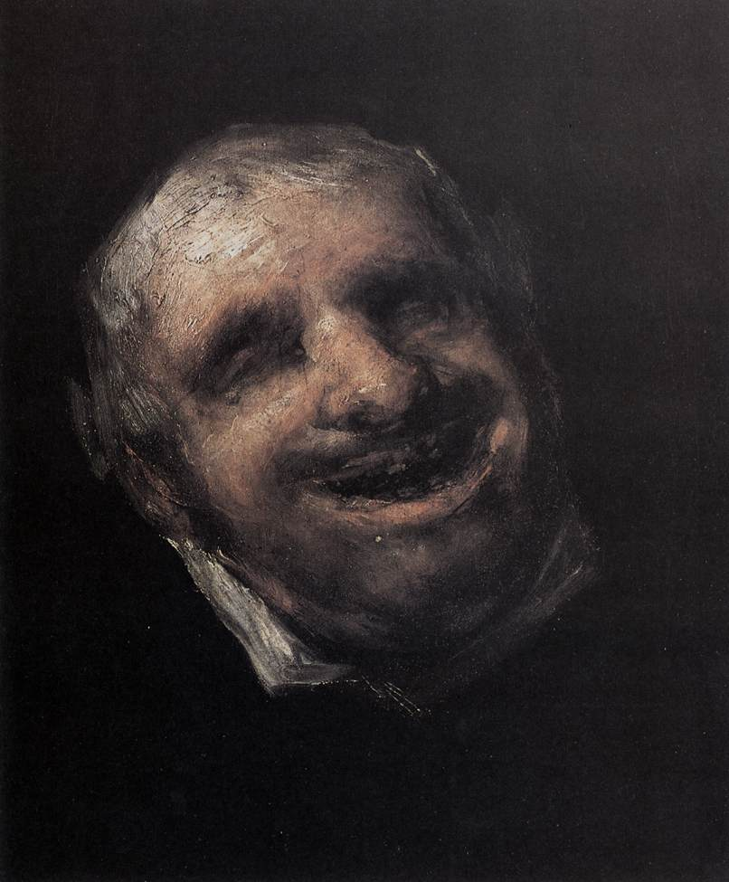
Close up study

Slide 35
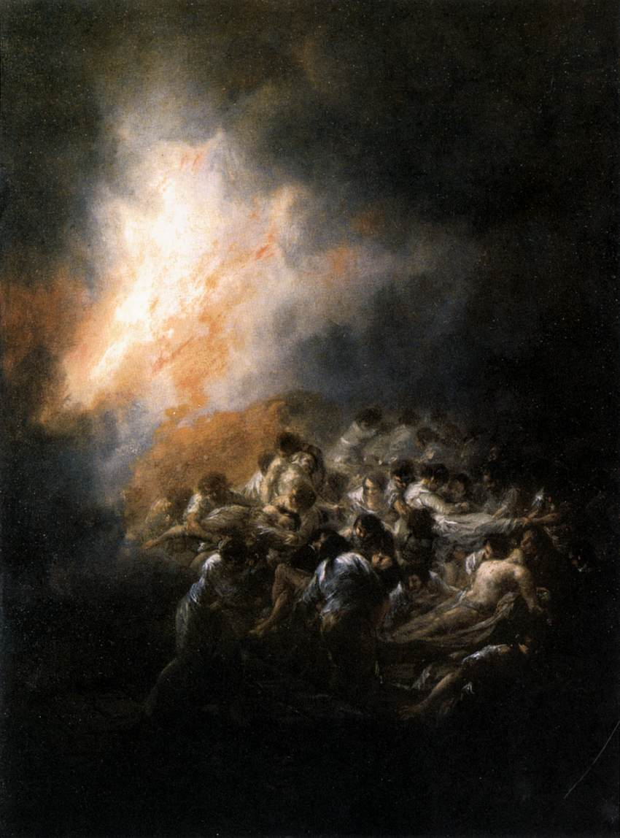

Slide 36
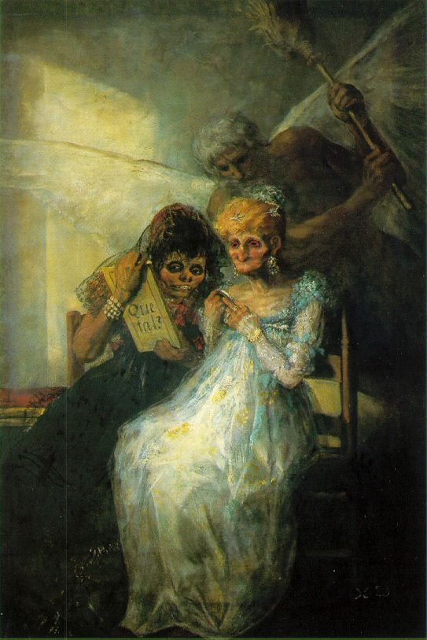
Time

Slide 37
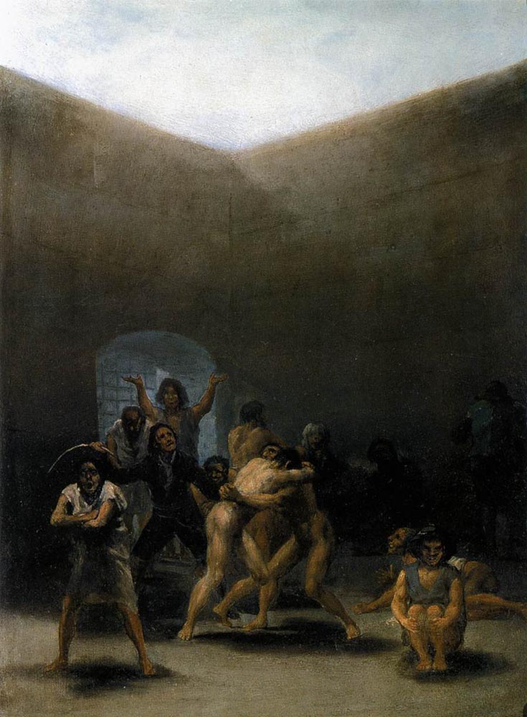
The Yard of a Madhouse

Slide 38
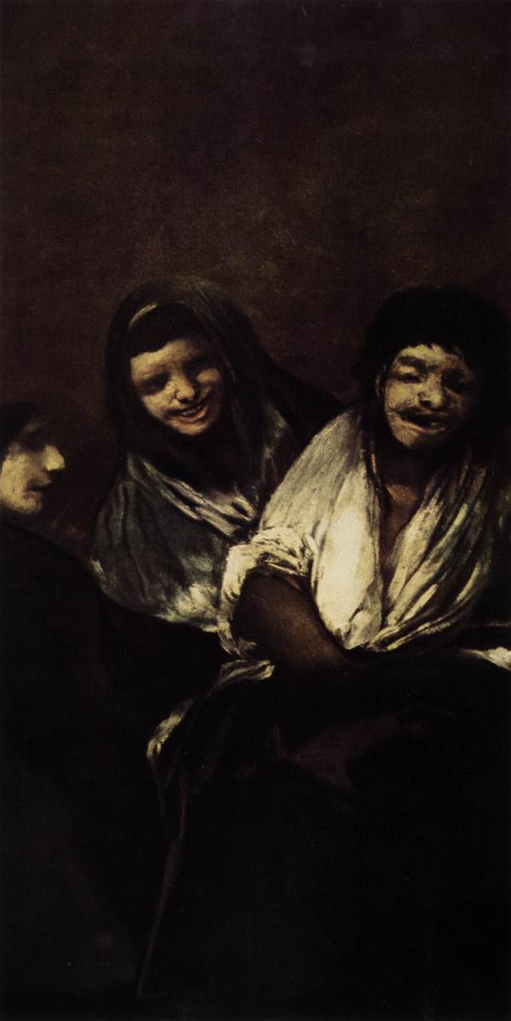
Two Women and a Man

Slide 39
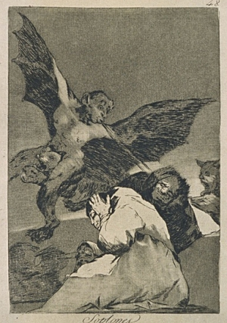
Goya’s Devil

Slide 40
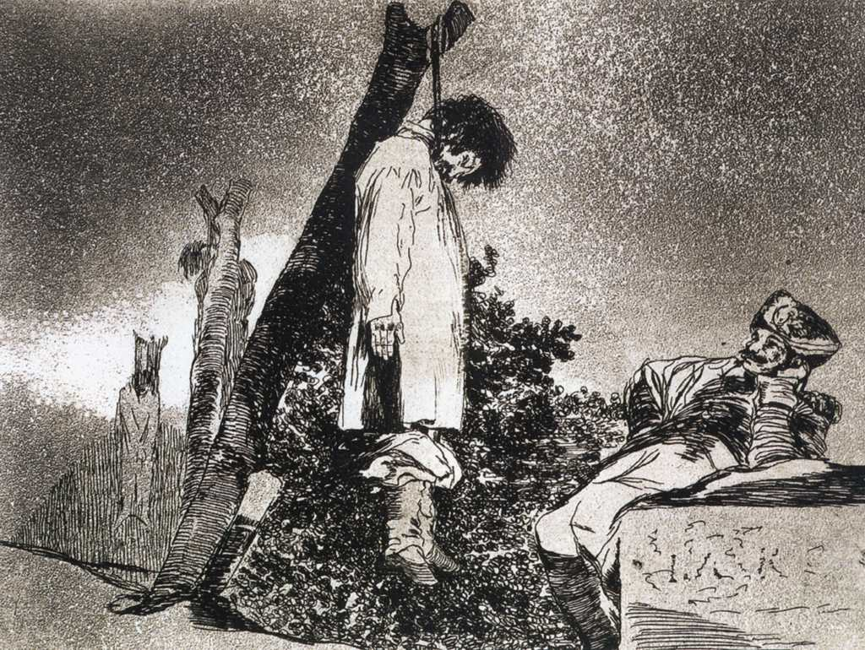

Slide 41
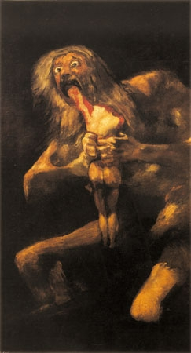
Saturn Devorning his Son

Slide 42
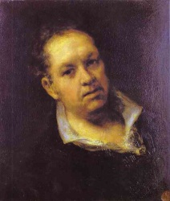
Self Portrait

Slide 43
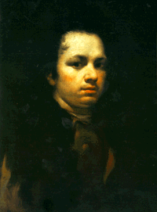
Self Portrait

Slide 44
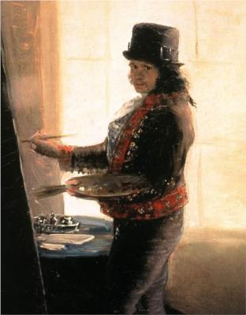
Self Portrait

Slide 45
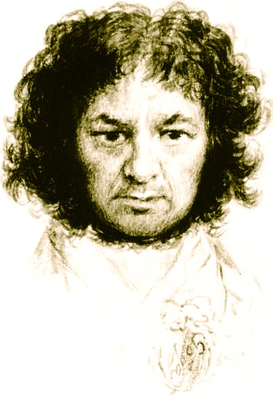
Self Portrait

